Slide 1
E-Commerce Data Base Design

Slide 2
Requirements
The e-commerce database needs to manage products, customers, orders, and payments effectively. For products, it should store details like name, price, and inventory. Customer information like name, email, and address should be securely stored, allowing for account creation and updates. Orders need to be tracked, including order ID, date, and items purchased, with options for modification or cancellation. Payment processing should be secure, supporting various methods like cards and PayPal, with transaction details stored for reference. Overall, the system should ensure data security, accuracy, and scalability for a smooth online shopping experience.

Slide 3
Conceptual design
Entities
Product
Customer
Order
Payment

Slide 4
Conceptual Design
Relationships
Product and Order: One-to-Many (Each order can contain multiple products)
Customer and Order: One-to-Many (Each customer can place multiple orders)
Order and Payment: One-to-One (Each order is associated with one payment)
Product and Payment: Many-to-Many (Multiple products can be associated with multiple payments, indicating purchase transactions)

Slide 5
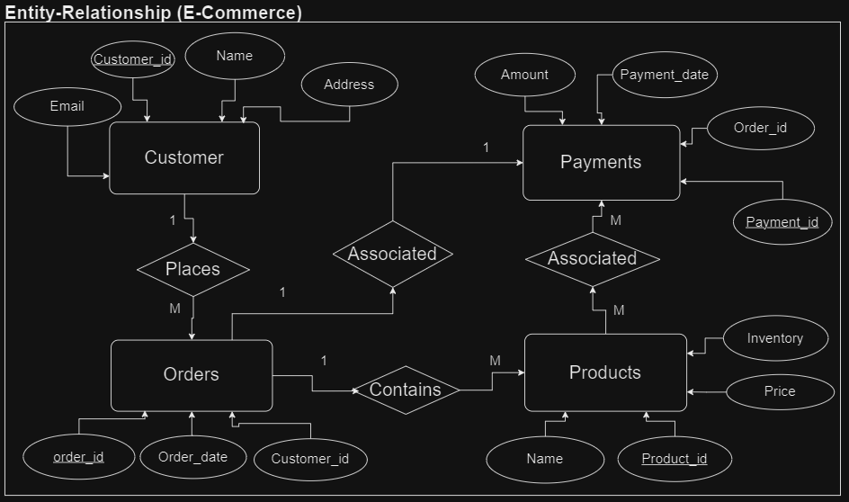
Conceptual Design

Slide 6
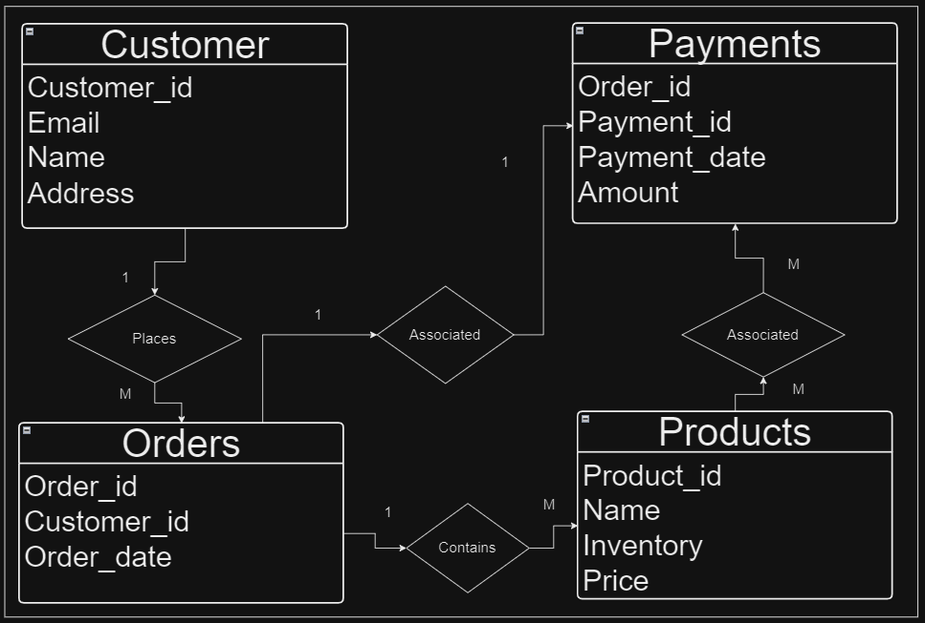
Logical Design

Slide 7
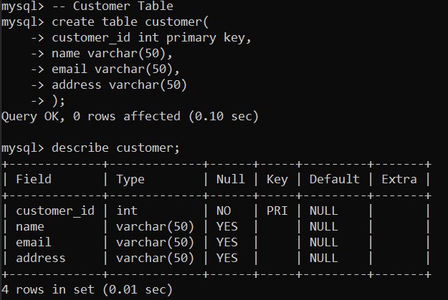
Physical Design (Implementation)

Slide 8
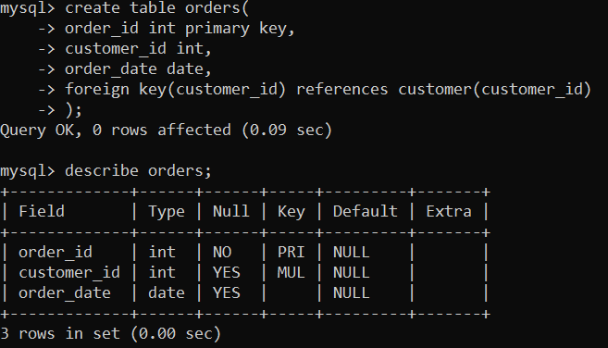
Physical Design (Implementation)

Slide 9
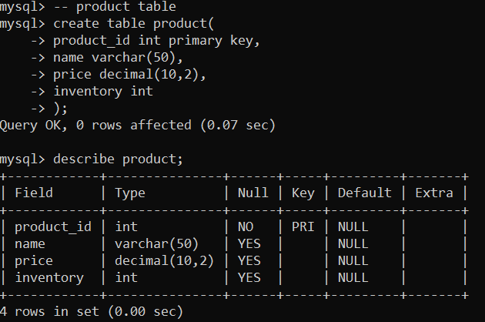
Physical Design (Implementation)

Slide 10
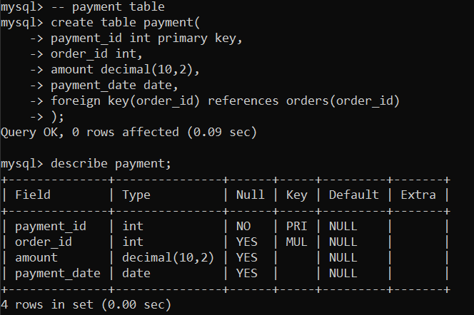
Physical Design (Implementation)

Slide 11
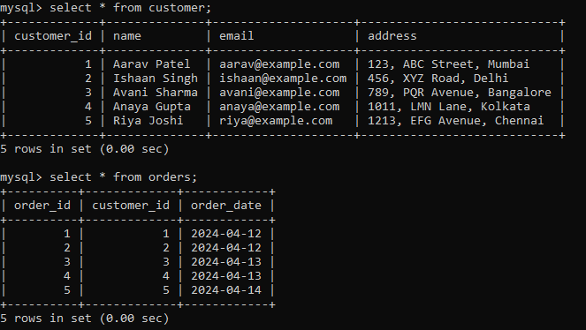
Physical Design (Implementation)

Slide 12
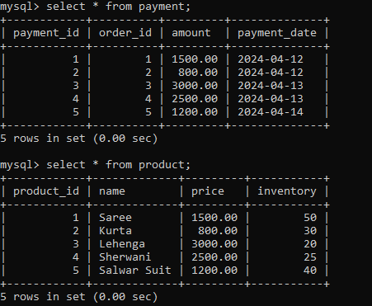
Physical Design (Implementation)

Slide 13
Conclusion
The database is designed to facilitate the management of products, orders, customers, and payments for an e-commerce platform.
Relationships exist between the tables, such as orders being associated with customers and payments being linked to orders.
Referential integrity is maintained through foreign key constraints to ensure data consistency and accuracy.

